Slide 1


2019 TECH(K)NOW Day Taipei
Let’s
For Web!
Benjamin Wang @ Golang Taiwan
2019.4.20
Notes:
https://github.com/golang-samples/gopher-vector

Slide 2
RESTful API Service

Slide 3
GET POST PUT PATCH DELETE

Slide 4
$ go get -u github.com/gin-gonic/gin

Slide 5
package main
import ( "github.com/gin-gonic/gin"
)
func main() {
log.Println("Start web service")
r := gin.Default()
r.Run(":8080")
}

Slide 6
package main
import (
"log"
"github.com/gin-gonic/gin"
)
func main() {
log.Println("Start web service")
r := gin.Default()
r.Run(":8080")
}

Slide 7
func main() {
log.Println("Start web service")
r := gin.Default()
r.GET("/", func(c *gin.Context) {
c.String(http.StatusOK, "Hello Go")
})
r.Run(":8080")
}

Slide 8
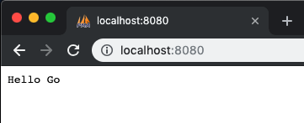

https://github.com/ashleymcnamara/gophers

Slide 9
r.GET("/", index)
func index(c *gin.Context) {
c.String(http.StatusOK, "Hello Go")
}

Slide 10
HTML Template

Slide 11
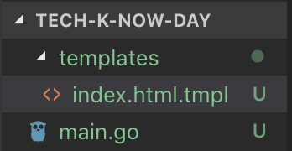
<html>
<head>
<title>Hello TECH(K)NOW Day</title>
</head>
<body>
<h1>Hello TECH(K)NOW Day</h1>
</body>
</html>

Slide 12
HTML Template extension name
thtml 0%
gohtml <1%
tpl 14%
tmpl 85% - html.tmpl

Slide 13
func main() {
log.Println("Start web service")
r := gin.Default()
r.LoadHTMLGlob("templates/*")
r.GET("/", index)
r.Run(":8080")
}
func index(c *gin.Context) {
c.HTML(http.StatusOK, "index.html.tmpl", gin.H{})
}

Slide 14

c.HTML(http.StatusOK, "index.html.tmpl", gin.H{
"Title": "Hello TECH(K)NOW Day",
})
<body>
<h1>{{.Title}}</h1>

Slide 15
Static Assets

Slide 16
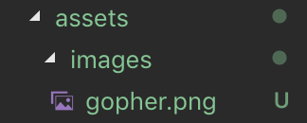
r := gin.Default()
r.Static("/assets", "./assets")
r.LoadHTMLGlob("templates/*")
<body>
<h1>Hello TECH(K)NOW Day</h1>
<img src="/assets/images/gopher.png" width="100">
</body>
https://github.com/golang-samples/gopher-vector

Slide 17
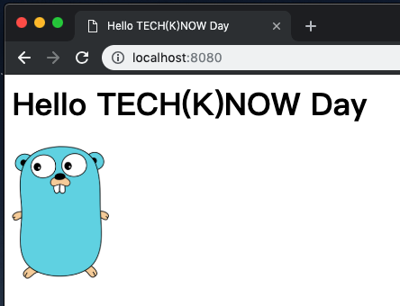

Slide 18
POST Form

Slide 19
r.POST("/login", login)

Slide 20
func login(c *gin.Context) {
username := c.PostForm("username")
log.Println("username:", username)
c.String(http.StatusOK, "Hi "+username)
}
<form action="/login" method="POST">
Username: <input type="text" name="username">
</form>

Slide 21
https://dev.to/deanveloper/the-gopher-is-not-dead-1m7k

